Slide 1
The Intel Architecture 32
(IA-32 Architecture)
Assembly Language
Computer Science Department
ACT

Slide 2
Presentation Outline
Basic Computer Organization
Intel Microprocessors
IA-32 Registers
Instruction Execution Cycle
IA-32 Memory Management

Slide 3
Basic Computer Organization
Since the 1940's, computers have 3 classic components:
  Processor, called also the CPU (Central Processing Unit)
  Memory and Storage Devices
  I/O Devices
Interconnected with one or more buses
Bus consists of
  Data Bus
  Address Bus
  Control Bus
data bus
registers
Processor
(CPU)
Memory
I/O
I/O
Device
Device
#1
#2
ALU
CU
clock
control bus
address bus

Slide 4
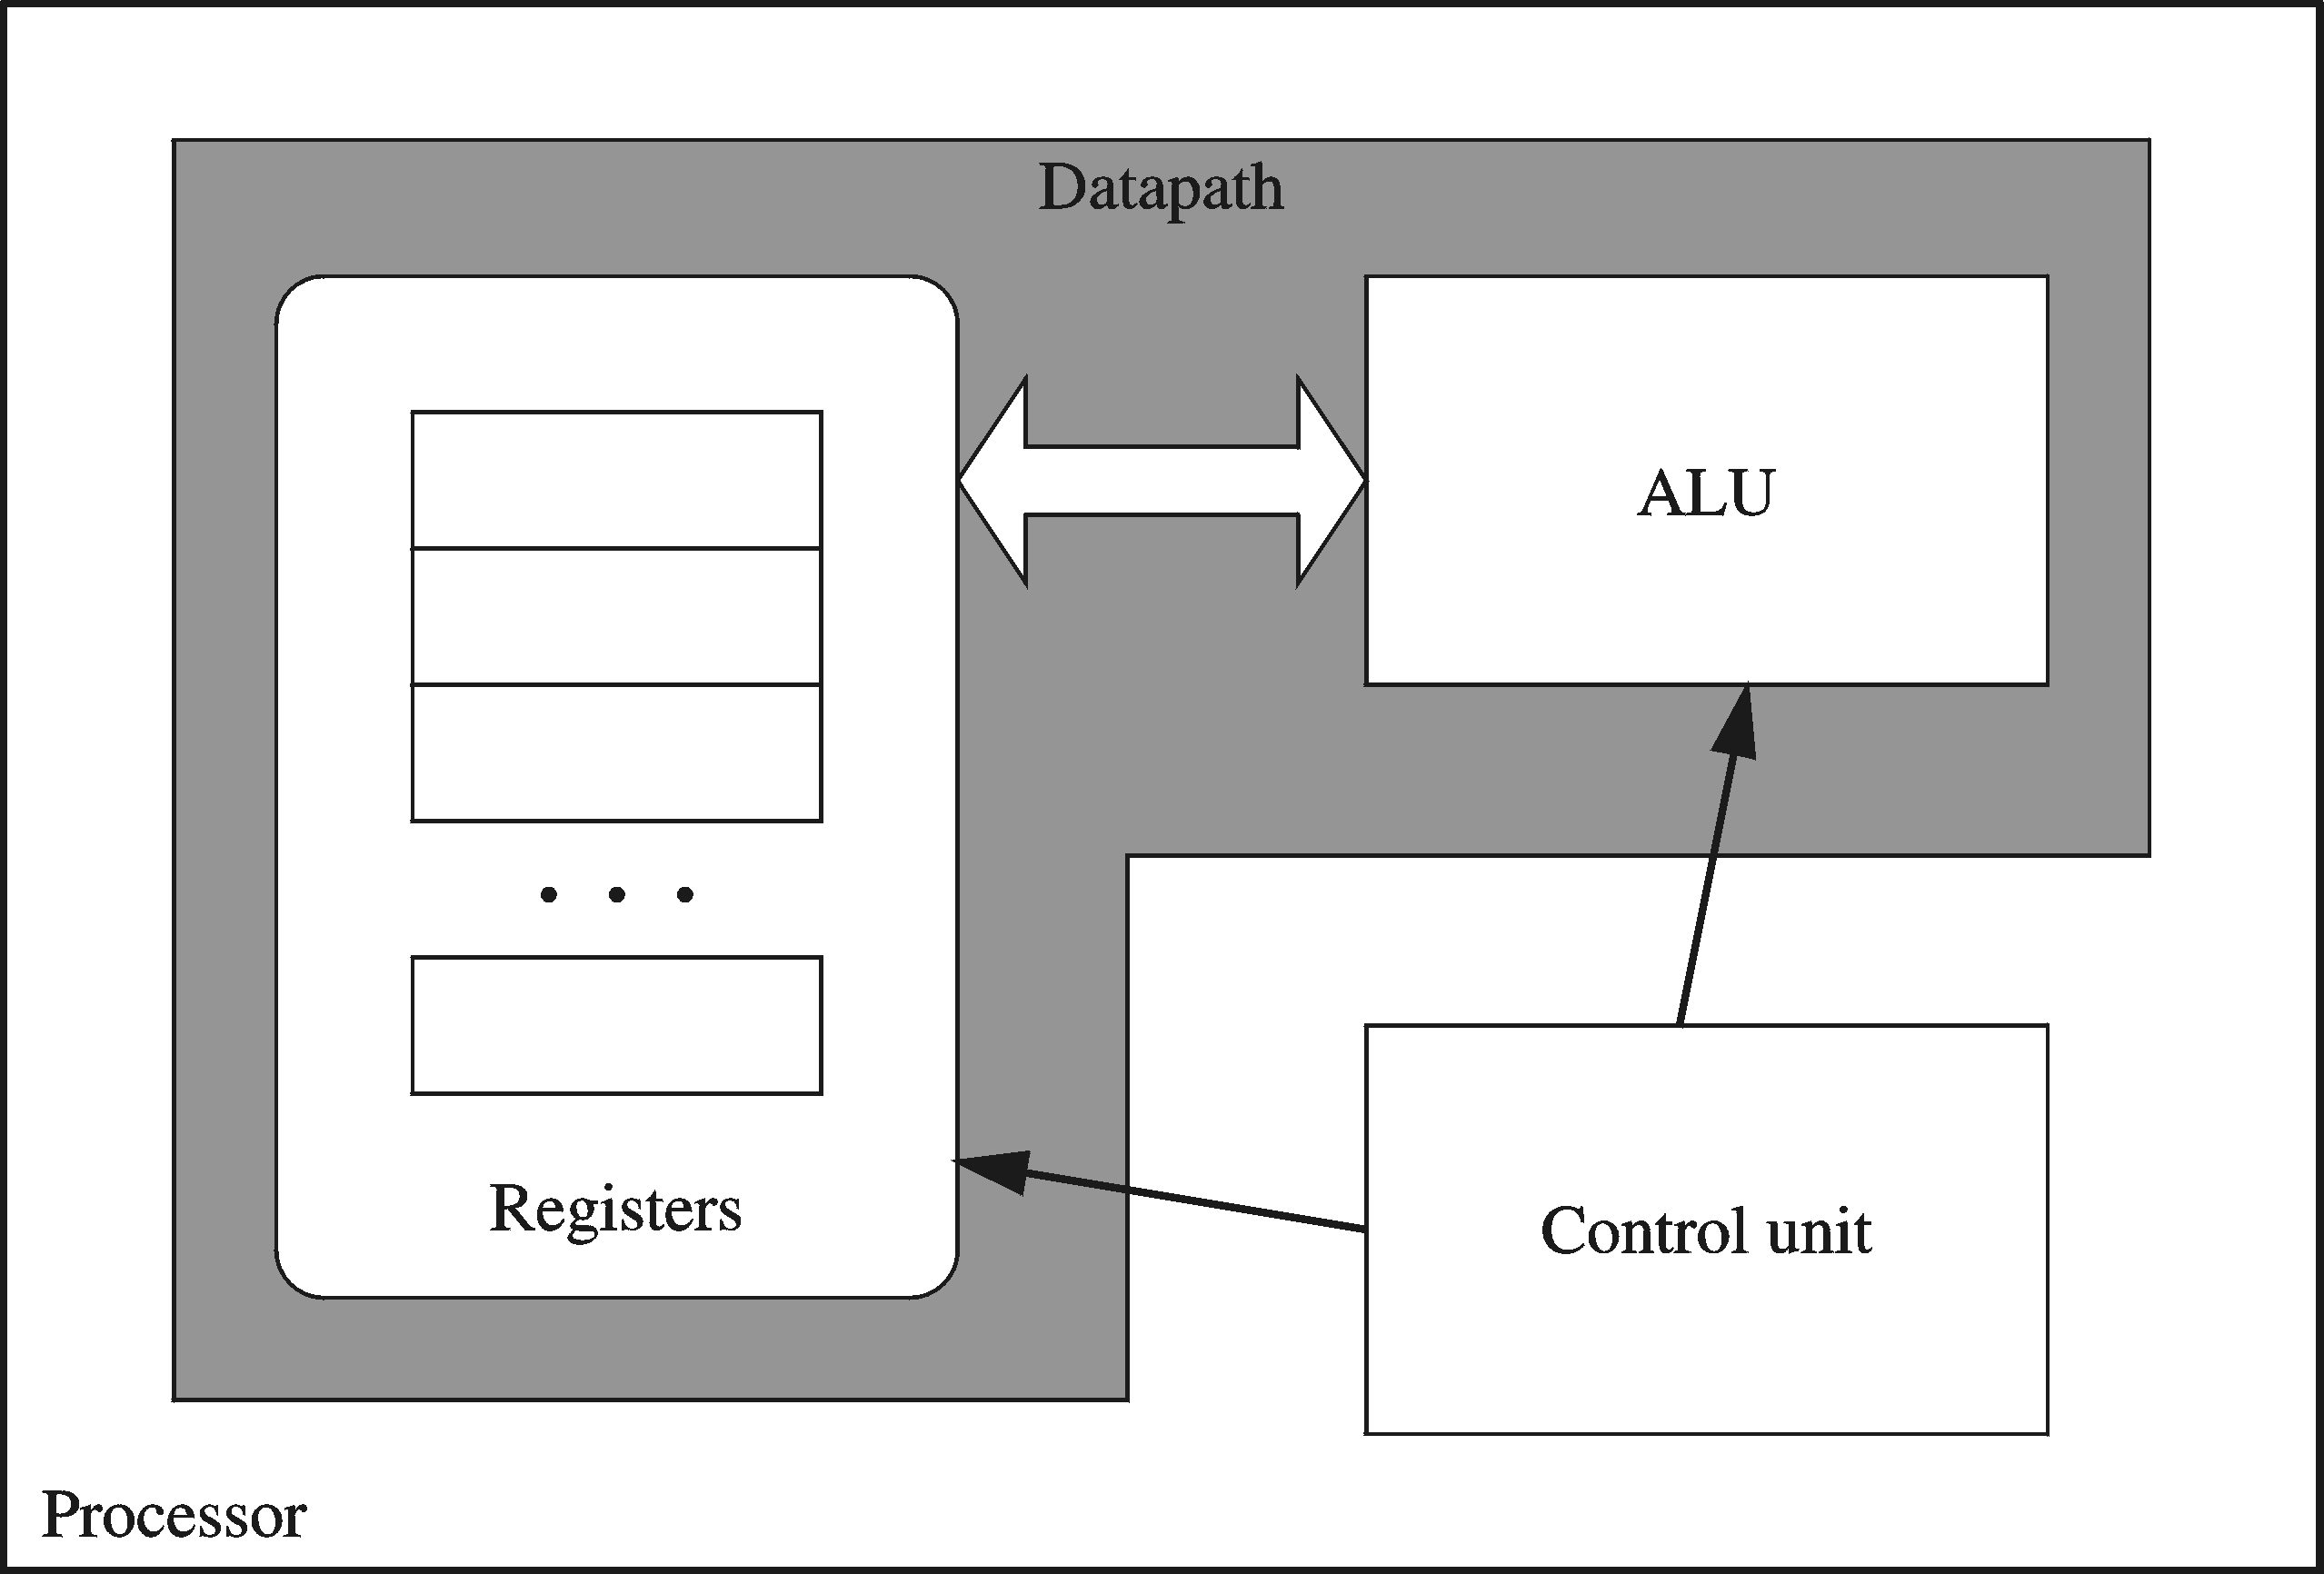
Processor
Processor consists of
  Datapath
    ALU
    Registers
  Control unit
ALU
  Performs arithmetic
  and logic instructions
Control unit (CU)
  Generates the control signals required to execute instructions
Implementation varies from one processor to another

Slide 5
Clock
Synchronizes Processor and Bus operations
Clock cycle = Clock period = 1 / Clock rate
Clock rate = Clock frequency = Cycles per second
  1 Hz = 1 cycle/sec 1 KHz = 10³ cycles/sec
  1 MHz = 10⁶ cycles/sec 1 GHz = 10⁹ cycles/sec
  2 GHz clock has a cycle time = 1/(2×10⁹) = 0.5 nanosecond (ns)
Clock cycles measure the execution of instructions
Cycle 1
Cycle 2
Cycle 3

Slide 6
Memory
Ordered sequence of bytes
  The sequence number is called the memory address
Byte addressable memory
  Each byte has a unique address
  Supported by almost all processors
Physical address space
  Determined by the address bus width
  Pentium has a 32-bit address bus
    Physical address space = 4GB = 2³² bytes
  Itanium with a 64-bit address bus can support
    Up to 2⁶⁴ bytes of physical address space

Slide 7
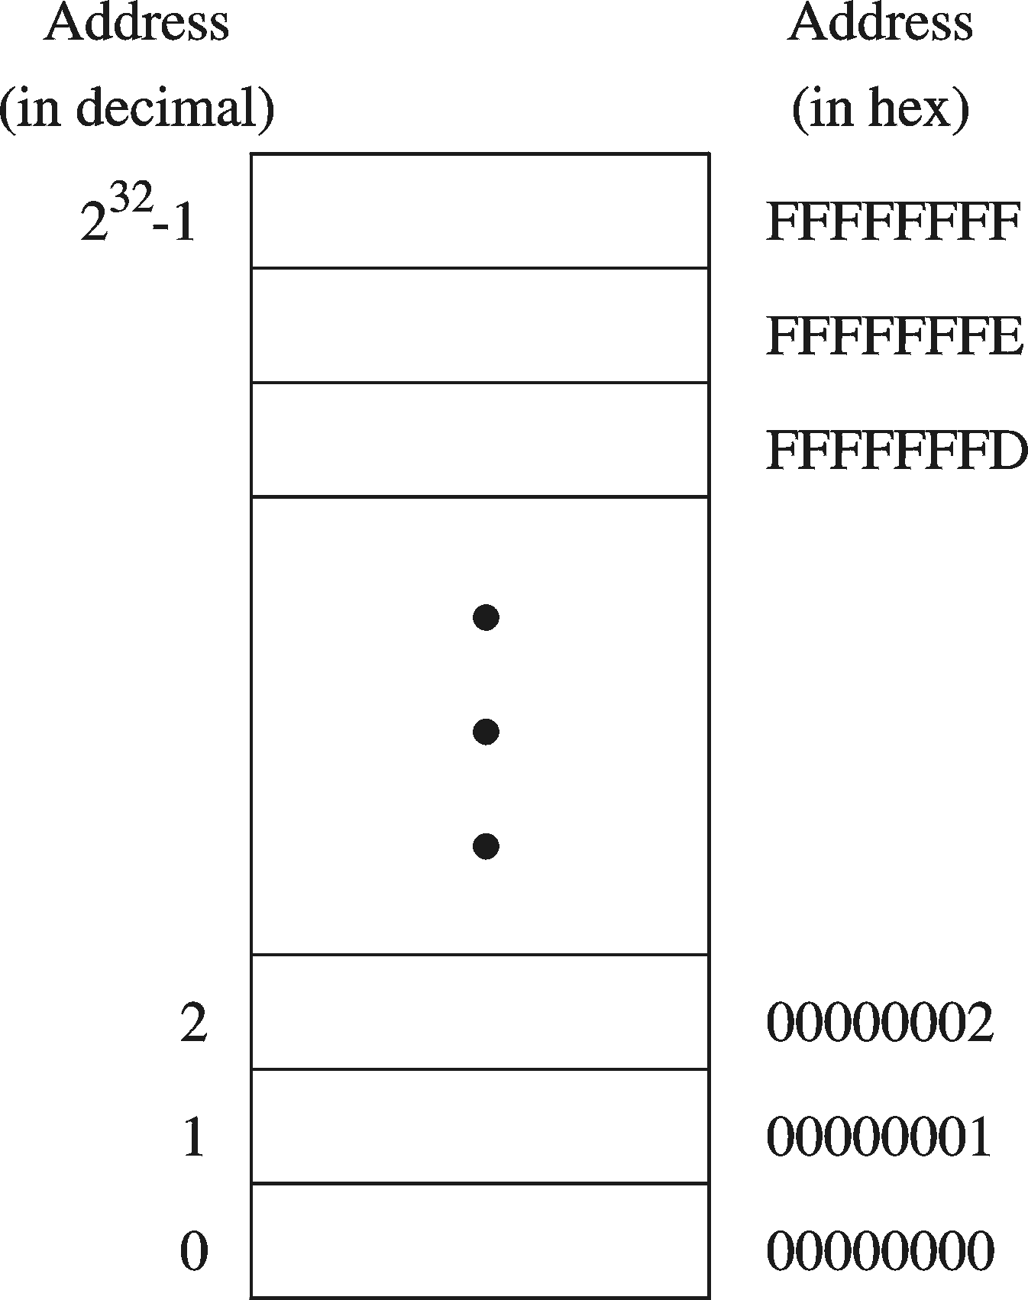
Address Space
Address Space is the set of memory locations (bytes) that can be addressed

Slide 8
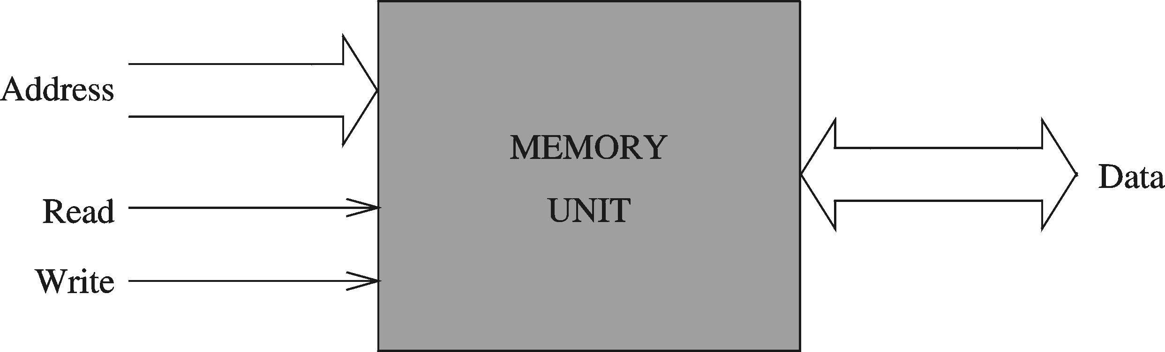
Memory Unit
Address Bus
  Address is placed on the address bus
  Address of location to be read/written
Data Bus
  Data is placed on the data bus
Two Control Signals
  Read
  Write
  Control whether memory should be read or written

Slide 9
Memory Read and Write Cycles
Read cycle
  1. Processor places address on the address bus
  2. Processor asserts the memory read control signal
  3. Processor waits for memory to place the data on the data bus
  4. Processor reads the data from the data bus
  Processor drops the memory read signal
Write cycle
  1. Processor places address on the address bus
  Processor asserts the memory write control signal
  Processor places the data on the data bus
  Wait for memory to store the data (wait states for slow memory)
  5. Processor drops the memory write signal

Slide 10
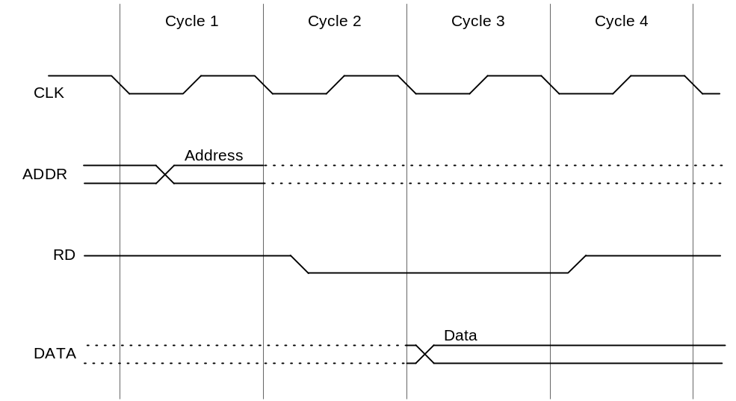
Reading from Memory
Multiple clock cycles are required
Memory responds much more slowly than the CPU
  Address is placed on address bus
  Read Line (RD) goes low, indicating that processor wants to read
  CPU waits (one or more cycles) for memory to respond
  Read Line (RD) goes high, indicating that data is on the data bus

Slide 11
Memory Devices
ROM = Read-Only Memory
  Stores information permanently (non-volatile)
  Used to store the information required to startup the computer
  Many types: ROM, EPROM, EEPROM, and FLASH
  FLASH memory can be erased electrically in blocks
RAM = Random Access Memory
  Volatile memory: data is lost when device is powered off
  Dynamic RAM (DRAM)
    Inexpensive, used for main memory, must be refreshed constantly
  Static RAM (SRAM)
    Expensive, used for cache memory, faster access, no refresh
  Video RAM (VRAM)
    Dual ported: read port to refresh the display, write port for updates

Slide 12
Memory Hierarchy
Registers
  Fastest storage elements, stores most frequently used data
  General-purpose registers: accessible to the programmer
  Special-purpose registers: used internally by the microprocessor
Cache Memory
  Fast SRAM that stores recently used instructions and data
  Recent processors have 2 levels
Main Memory (DRAM)
Disk Storage
  Permanent magnetic
  storage for files
registers
cache memory
higher speed, smaller size
lower cost per byte
main memory
disk storage

Slide 13
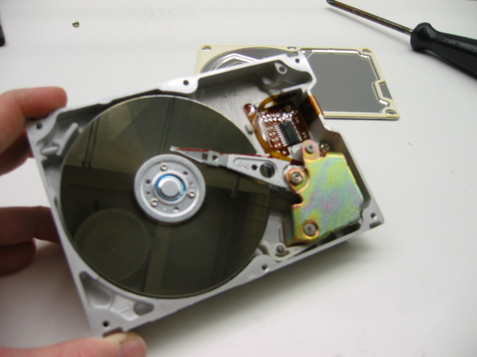
Magnetic Disk Storage
Disk Access Time =
Seek Time +
Rotation Latency +
Transfer Time
Sector
Read/write head
Actuator
Recording area
Seek Time: head movement to the desired track (milliseconds)
Rotation Latency: disk rotation until desired sector arrives under the head
Transfer Time: to transfer one sector
Track 2
Track 1
Track 0
Arm
Direction of rotation
Platter
Spindle

Slide 14
Example on Disk Access Time
Given a magnetic disk with the following properties
  Rotation speed = 7200 RPM (rotations per minute)
  Average seek = 8 ms, Sector = 512 bytes, Track = 200 sectors
Calculate
  Time of one rotation (in milliseconds)
  Average time to access a block of 32 consecutive sectors
Answer
  Rotations per second
  Rotation time in milliseconds
  Average rotational latency
  Time to transfer 32 sectors
  Average access time
  = 7200/60 = 120 RPS
= 1000/120 = 8.33 ms
= time of half rotation = 4.17 ms
= (32/200) * 8.33 = 1.33 ms
= 8 + 4.17 + 1.33 = 13.5 ms

Slide 15
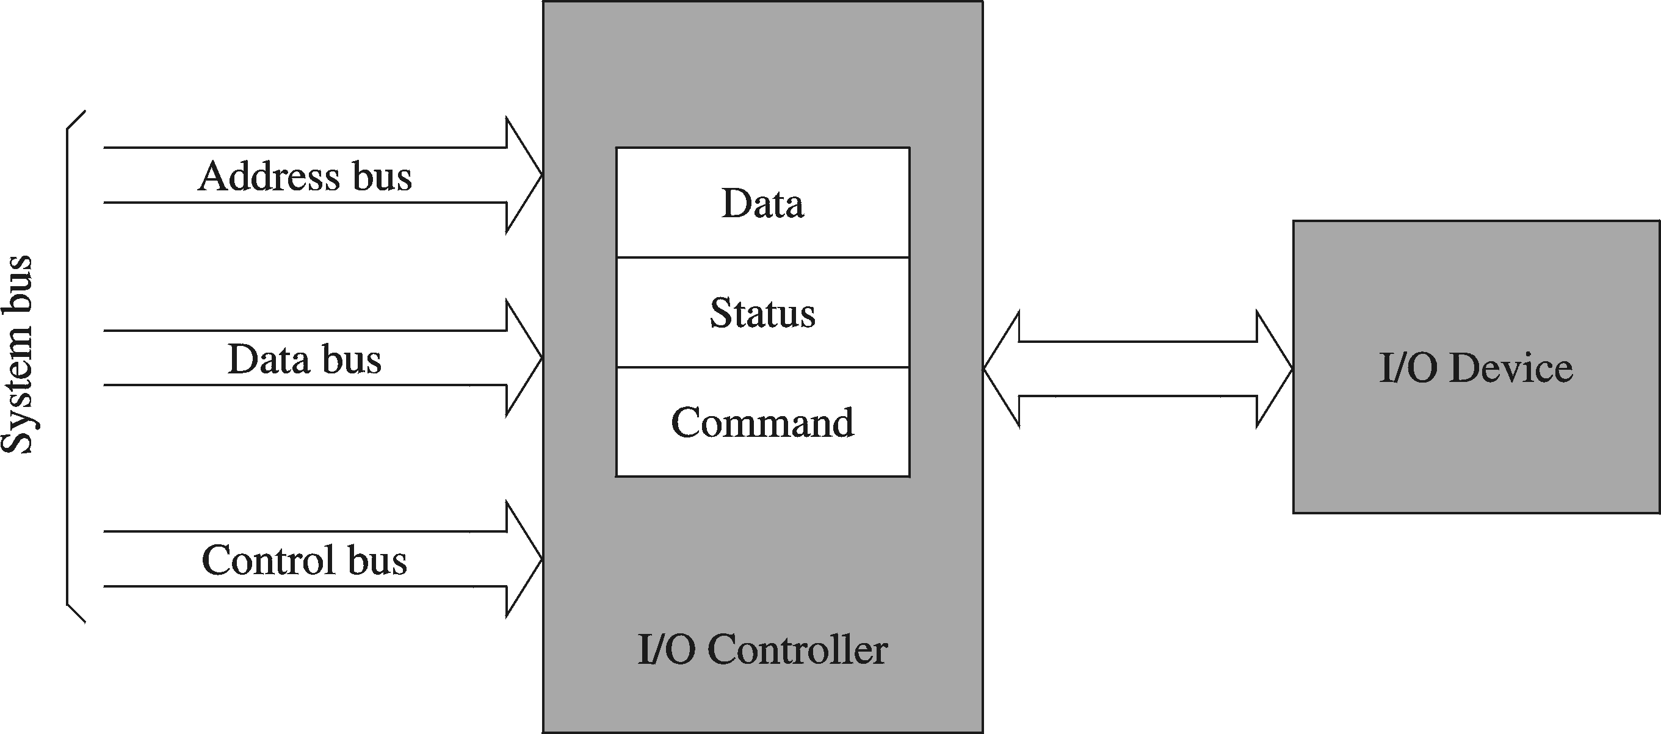
I/O Controllers
I/O devices are interfaced via an I/O controller
  I/O controller uses the system bus to communicate with processor
  I/O controller takes care of low-level operation details

Slide 16
Next ...
Basic Computer Organization
Intel Microprocessors
IA-32 Registers
Instruction Execution Cycle
IA-32 Memory Management

Slide 17
Intel Microprocessors
Intel introduced the 8086 microprocessor in 1979
8086, 8087, 8088, and 80186 processors
  16-bit processors with 16-bit registers
  16-bit data bus and 20-bit address bus
    Physical address space = 2²⁰ bytes = 1 MB
  8087 Floating-Point co-processor
  Uses segmentation and real-address mode to address memory
    Each segment can address 2¹⁶ bytes = 64 KB
  8088 is a less expensive version of 8086
    Uses an 8-bit data bus
  80186 is a faster version of 8086

Slide 18
Intel 80286 and 80386 Processors
80286 was introduced in 1982
  24-bit address bus ⇒ 2²⁴ bytes = 16 MB address space
  Introduced protected mode
    Segmentation in protected mode is different from the real mode
80386 was introduced in 1985
  First 32-bit processor with 32-bit general-purpose registers
  First processor to define the IA-32 architecture
  32-bit data bus and 32-bit address bus
  2³² bytes ⇒ 4 GB address space
  Introduced paging, virtual memory, and the flat memory model
    Segmentation can be turned off

Slide 19
Intel 80486 and Pentium Processors
80486 was introduced 1989
  Improved version of Intel 80386
  On-chip Floating-Point unit (DX versions)
  On-chip unified Instruction/Data Cache (8 KB)
  Uses Pipelining: can execute up to 1 instruction per clock cycle
Pentium (80586) was introduced in 1993
  Wider 64-bit data bus, but address bus is still 32 bits
  Two execution pipelines: U-pipe and V-pipe
    Superscalar performance: can execute 2 instructions per clock cycle
  Separate 8 KB instruction and 8 KB data caches
  MMX instructions (later models) for multimedia applications

Slide 20
Intel P6 Processor Family
P6 Processor Family: Pentium Pro, Pentium II and III
Pentium Pro was introduced in 1995
  Three-way superscalar: can execute 3 instructions per clock cycle
  36-bit address bus ⇒ up to 64 GB of physical address space
  Introduced dynamic execution
    Out-of-order and speculative execution
  Integrates a 256 KB second level L2 cache on-chip
Pentium II was introduced in 1997
  Added MMX instructions (already introduced on Pentium MMX)
Pentium III was introduced in 1999
  Added SSE instructions and eight new 128-bit XMM registers

Slide 21
Pentium 4 and Xeon Family
Pentium 4 is a seventh-generation x86 architecture
  Introduced in 2000
  New micro-architecture design called Intel Netburst
  Very deep instruction pipeline, scaling to very high frequencies
  Introduced the SSE2 instruction set (extension to SSE)
    Tuned for multimedia and operating on the 128-bit XMM registers
In 2002, Intel introduced Hyper-Threading technology
  Allowed 2 programs to run simultaneously, sharing resources
Xeon is Intel's name for its server-class microprocessors
  Xeon chips generally have more cache
  Support larger multiprocessor configurations

Slide 22
Pentium-M and EM64T
Pentium M (Mobile) was introduced in 2003
  Designed for low-power laptop computers
  Modified version of Pentium III, optimized for power efficiency
  Large second-level cache (2 MB on later models)
  Runs at lower clock than Pentium 4, but with better performance
Extended Memory 64-bit Technology (EM64T)
  Introduced in 2004
  64-bit superset of the IA-32 processor architecture
  64-bit general-purpose registers and integer support
  Number of general-purpose registers increased from 8 to 16
  64-bit pointers and flat virtual address space
  Large physical address space: up to 2⁴⁰ = 1 Terabytes

Slide 23
CISC and RISC
CISC – Complex Instruction Set Computer
  Large and complex instruction set
  Variable width instructions
  Requires microcode interpreter
    Each instruction is decoded into a sequence of micro-operations
  Example: Intel x86 family
RISC – Reduced Instruction Set Computer
  Small and simple instruction set
  All instructions have the same width
  Simpler instruction formats and addressing modes
  Decoded and executed directly by hardware
  Examples: ARM, MIPS, PowerPC, SPARC, etc.

Slide 24
Next ...
Basic Computer Organization
Intel Microprocessors
IA-32 Registers
Instruction Execution Cycle
IA-32 Memory Management

Slide 25
Basic Program Execution Registers
Registers are high speed memory inside the CPU
  Eight 32-bit general-purpose registers
  Six 16-bit segment registers
  Processor Status Flags (EFLAGS) and Instruction Pointer (EIP)
32-bit General-Purpose Registers
EAX
EBP
EBX
ESP
ECX
ESI
EDX
EDI
16-bit Segment Registers
EFLAGS
CS
ES
SS
FS
EIP
DS
GS

Slide 26
General-Purpose Registers
Used primarily for arithmetic and data movement
  mov eax, 10 move constant 10 into register eax
Specialized uses of Registers
  EAX – Accumulator register
    Automatically used by multiplication and division instructions
  ECX – Counter register
    Automatically used by LOOP instructions
  ESP – Stack Pointer register
    Used by PUSH and POP instructions, points to top of stack
  ESI and EDI – Source Index and Destination Index register
    Used by string instructions
  EBP – Base Pointer register
    Used to reference parameters and local variables on the stack

Slide 27



Accessing Parts of Registers
EAX, EBX, ECX, and EDX are 32-bit Extended registers
  Programmers can access their 16-bit and 8-bit parts
  Lower 16-bit of EAX is named AX
  AX is further divided into
    AL = lower 8 bits
    AH = upper 8 bits
ESI, EDI, EBP, ESP have only
16-bit names for lower half

Slide 28
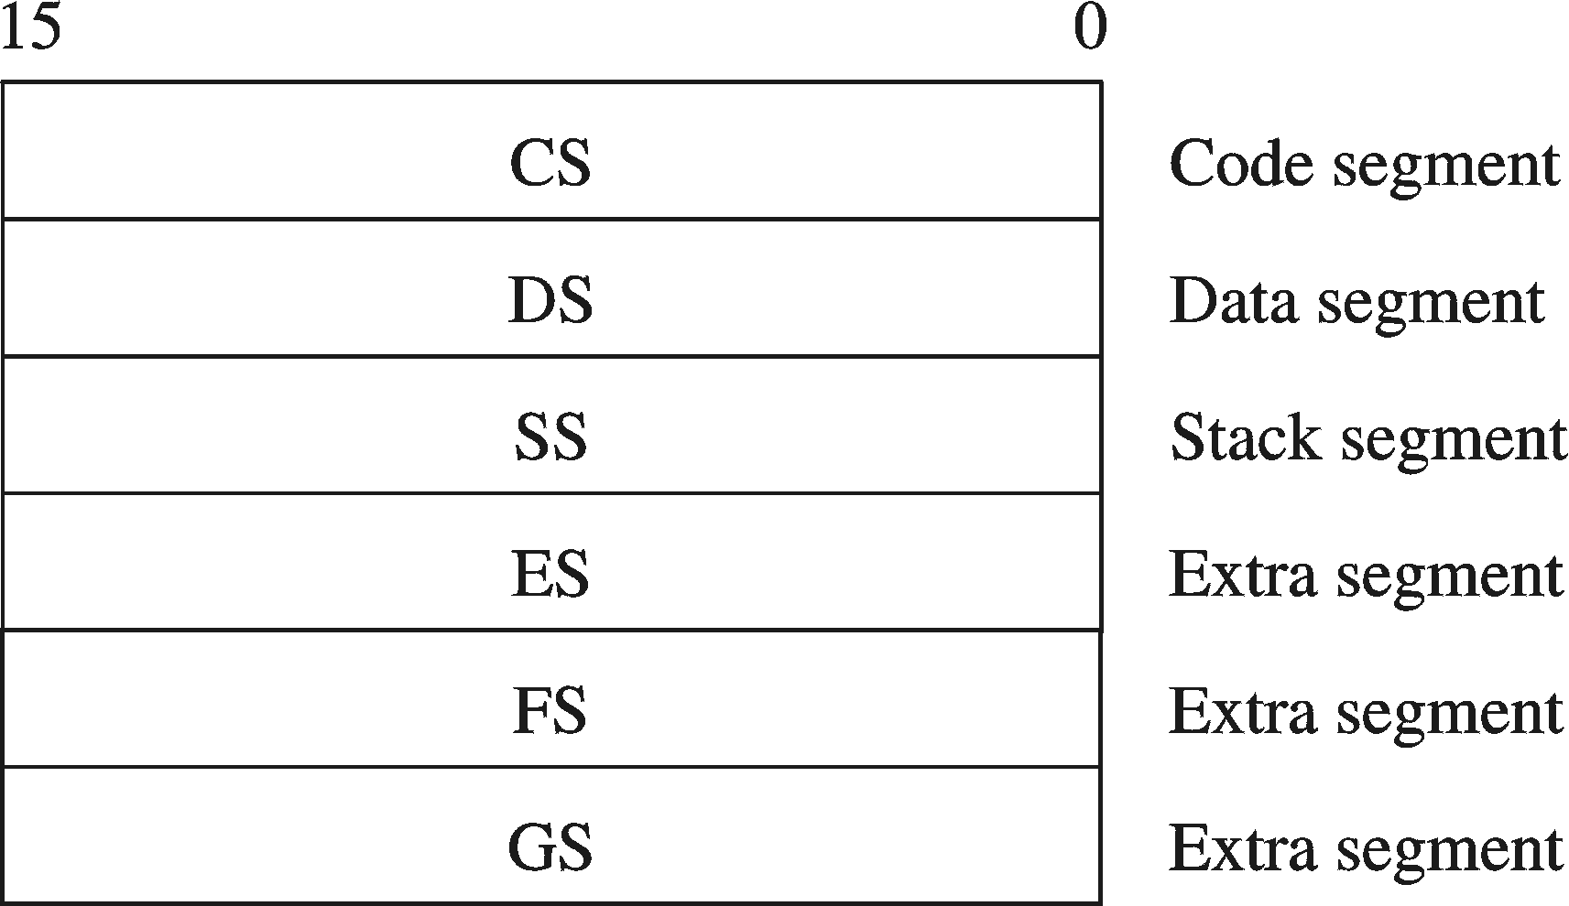
Special-Purpose & Segment Registers
EIP = Extended Instruction Pointer
  Contains address of next instruction to be executed
EFLAGS = Extended Flags Register
  Contains status and control flags
  Each flag is a single binary bit
Six 16-bit Segment Registers
  Support segmented memory
  Six segments accessible at a time
  Segments contain distinct contents
    Code
    Data
    Stack

Slide 29
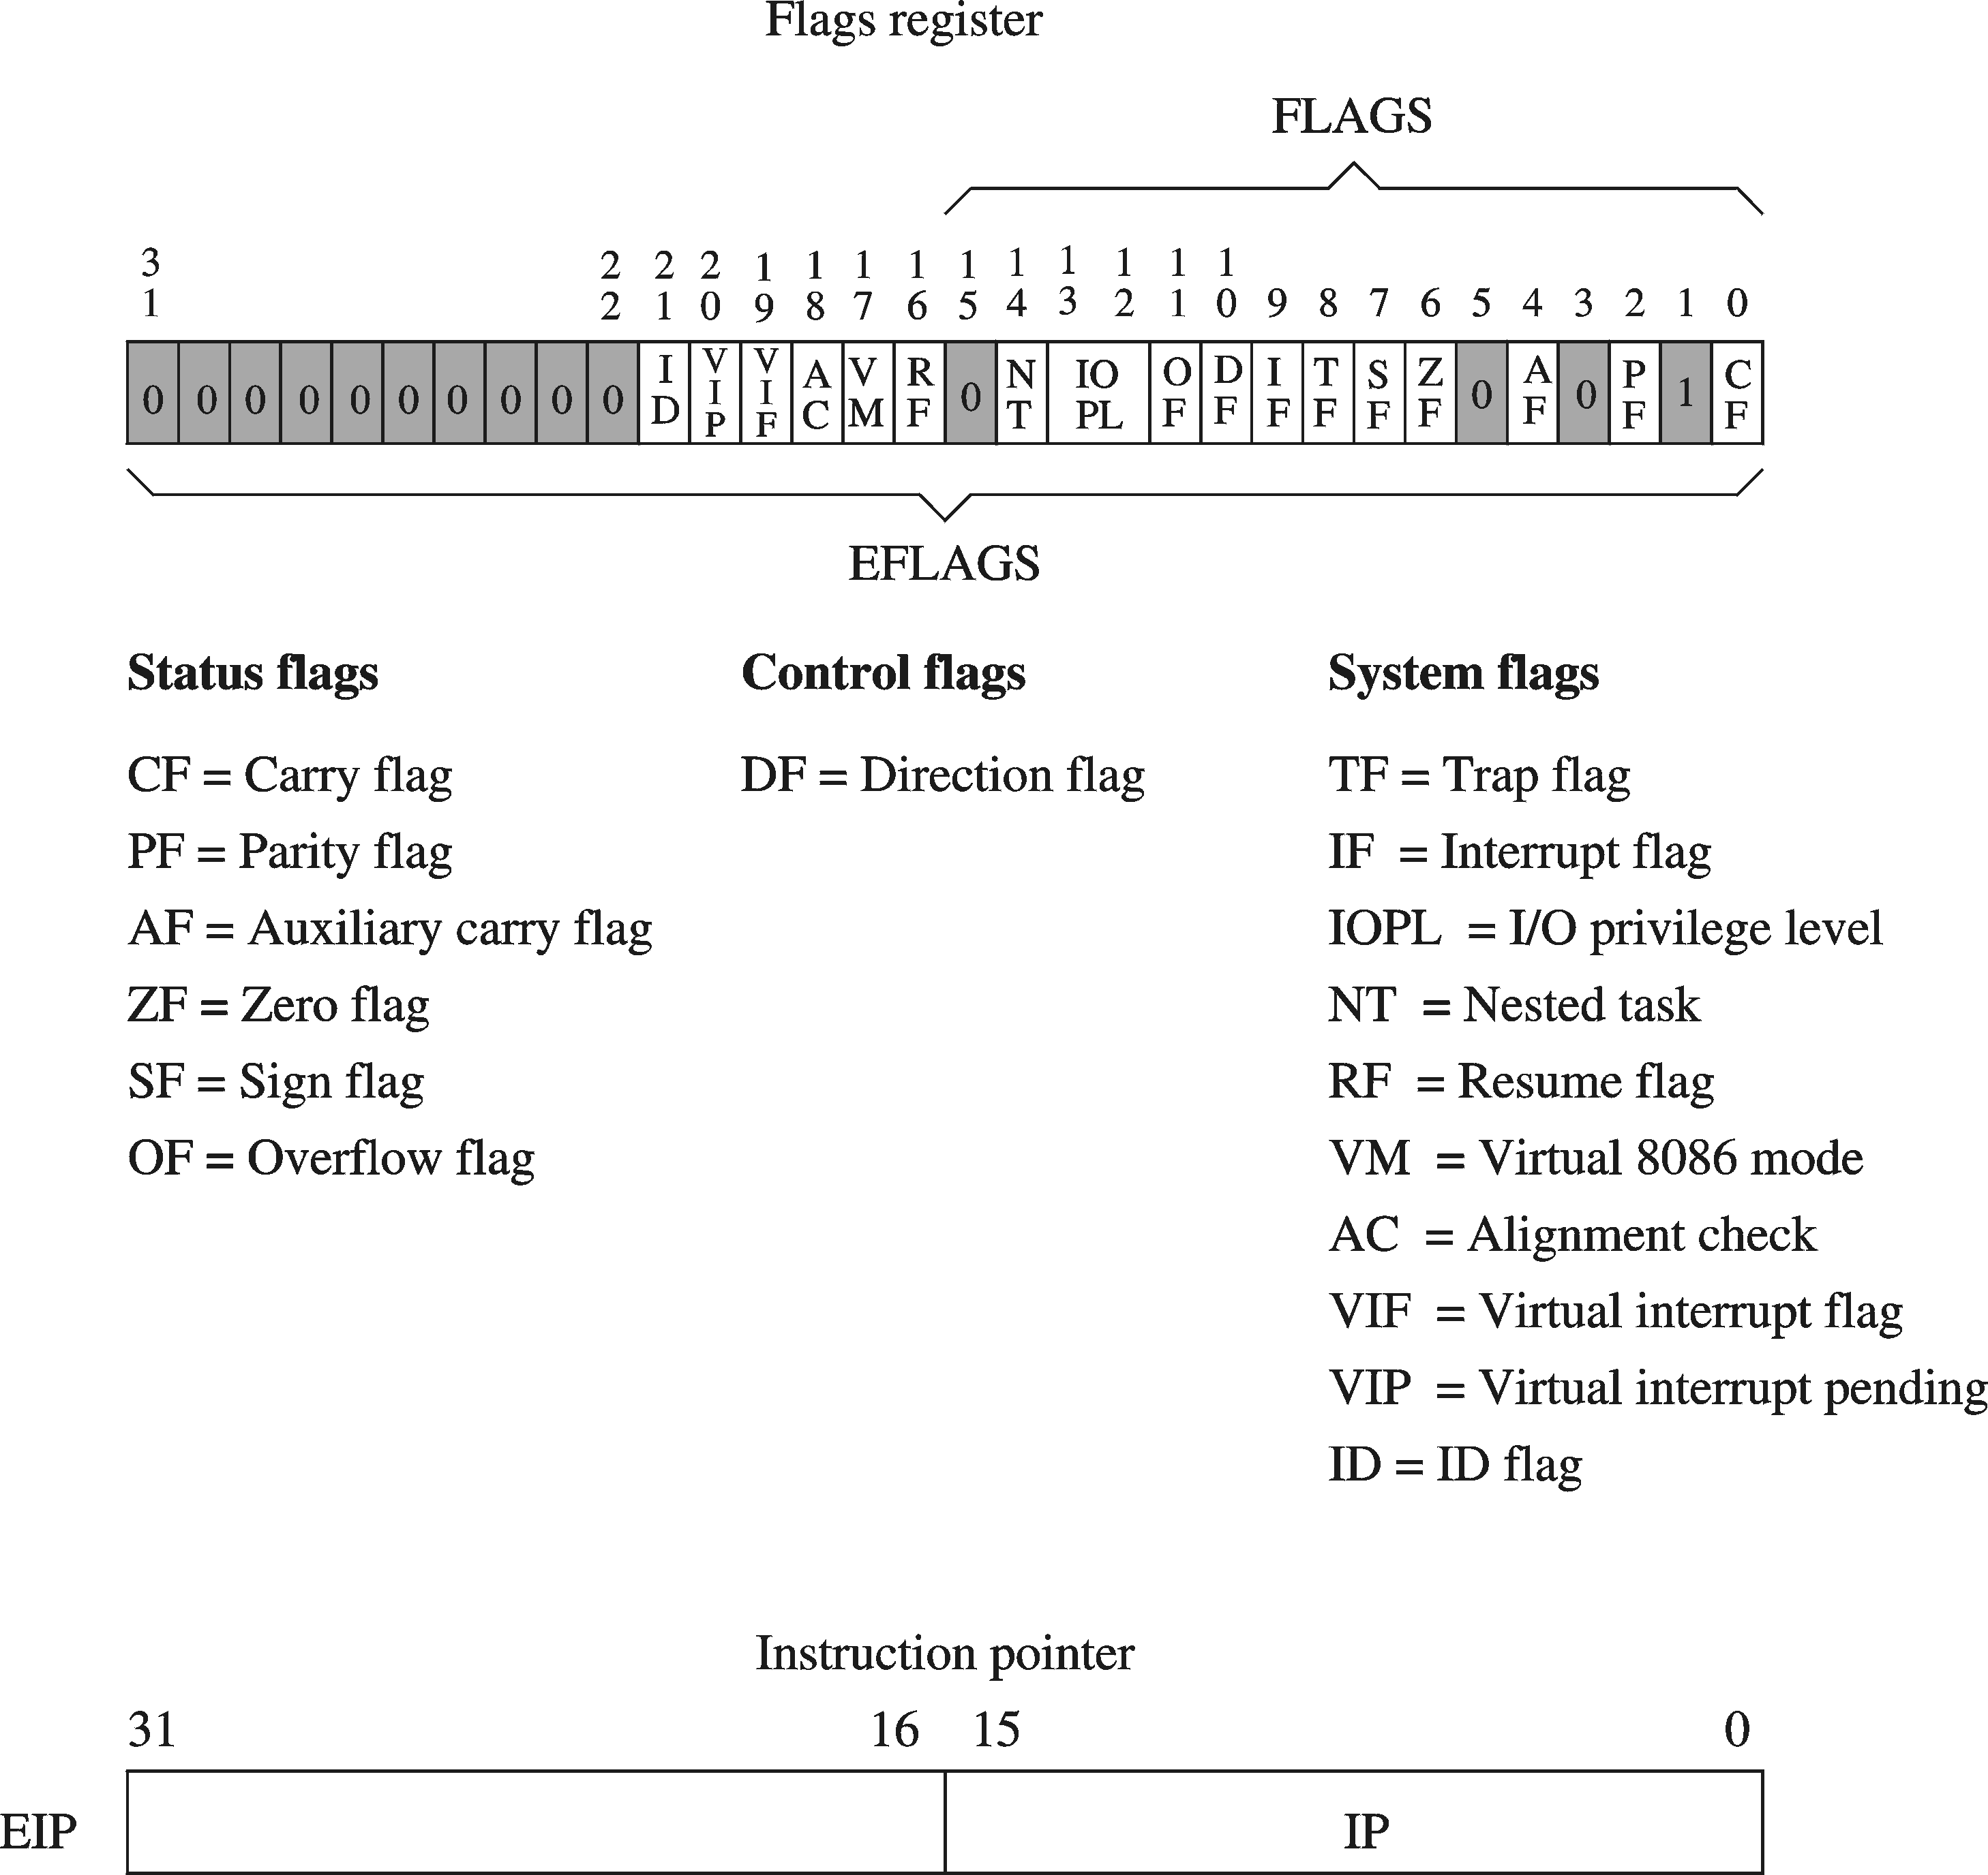
EFLAGS Register
Status Flags
  Status of arithmetic and logical operations
Control and System flags
  Control the CPU operation
Programs can set and clear individual bits in the EFLAGS register

Slide 30
Status Flags
Carry Flag
  Set when unsigned arithmetic result is out of range
Overflow Flag
  Set when signed arithmetic result is out of range
Sign Flag
  Copy of sign bit, set when result is negative
Zero Flag
  Set when result is zero
Auxiliary Carry Flag
  Set when there is a carry from bit 3 to bit 4
Parity Flag
  Set when parity is even
  Least-significant byte in result contains even number of 1s

Slide 31

Floating-Point, MMX, XMM Registers
Floating-point unit performs high speed FP operations
Eight 80-bit floating-point data registers
  ST(0), ST(1), . . . , ST(7)
  Arranged as a stack
  Used for floating-point arithmetic
Eight 64-bit MMX registers
  Used with MMX instructions
Eight 128-bit XMM registers
  Used with SSE instructions

Slide 32
Next ...
Basic Computer Organization
Intel Microprocessors
IA-32 Registers
Instruction Execution Cycle
IA-32 Memory Management

Slide 33
Instruction Execute Cycle
Instruction
Fetch
Obtain instruction from program storage
Instruction
Decode
Determine required actions and instruction size
Operand
Fetch
Infinite Cycle
Locate and obtain operand data
Execute
Compute result value and status
Writeback
Result
Deposit results in storage for later use

Slide 34
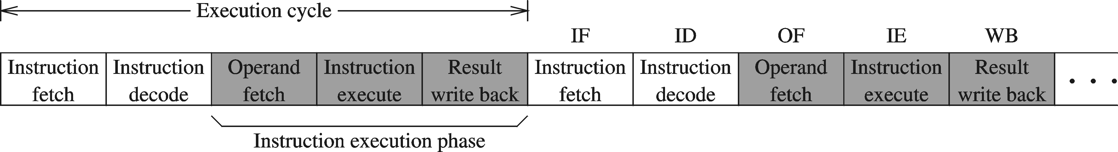
Instruction Execution Cycle – cont'd
Instruction Fetch
Instruction Decode
Operand Fetch
Execute
Result Writeback
PC
program
I1
I2
I3
I4
. . .
memory
fetch
op1
read
op2
registers
registers
I1
instruction
register
decode
write
write
flags
ALU
execute
(output)

Slide 35
Pipelined Execution
Instruction execution can be divided into stages
Pipelining makes it possible to start an instruction before completing the execution of previous one
Stages
For k stages and n instructions, the number of required cycles is: k + n – 1
S1
S2
S3
S4
S5
S6
1
I-1
2
I-1
3
I-1
4
I-1
5
I-1
Cycles
6
Non-pipelined execution
Wasted clock cycles
I-1
7
I-2
8
I-2
9
I-2
Pipelined
Execution
10
I-2
11
I-2
12
I-2

Slide 36
Wasted Cycles (pipelined)
When one of the stages requires two or more clock cycles to complete, clock cycles are again wasted
  Assume that stage S4 is the execute stage
  Assume also that S4 requires 2 clock cycles to complete
  As more instructions enter the pipeline, wasted cycles occur
  For k stages, where one stage requires 2 cycles, n instructions require k + 2n – 1 cycles
Stages
exe
S1
S2
S3
S4
S5
S6
1
I-1
2
I-2
I-1
3
I-3
I-2
I-1
4
I-3
I-2
I-1
Cycles
5
I-3
I-1
6
I-2
I-1
7
I-2
I-1
8
I-3
I-2
9
I-3
I-2
10
I-3
11
I-3

Slide 37
Superscalar Architecture
A superscalar processor has multiple execution pipelines
The Pentium processor has two execution pipelines
  Called U and V pipes
In the following, stage
S4 has 2 pipelines
  Each pipeline still
  requires 2 cycles
  Second pipeline
  eliminates wasted cycles
  For k stages and n
  instructions, number of
  cycles = k + n

Slide 38
Next ...
Basic Computer Organization
Intel Microprocessors
IA-32 Registers
Instruction Execution Cycle
IA-32 Memory Management

Slide 39
Modes of Operation
Real-Address mode (original mode provided by 8086)
  Only 1 MB of memory can be addressed, from 0 to FFFFF (hex)
  Programs can access any part of main memory
  MS-DOS runs in real-address mode
Protected mode (introduced with the 80386 processor)
  Each program can address a maximum of 4 GB of memory
  The operating system assigns memory to each running program
  Programs are prevented from accessing each other’s memory
  Native mode used by Windows NT, 2000, XP, and Linux
Virtual 8086 mode
  Processor runs in protected mode, and creates a virtual 8086 machine with 1 MB of address space for each running program

Slide 40
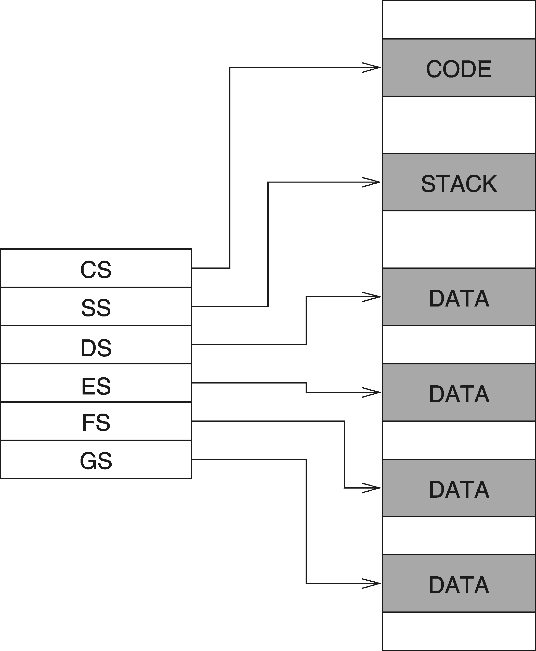
Real Address Mode
A program can access up to six segments at any time
  Code segment
  Stack segment
  Data segment
  Extra segments (up to 3)
Each segment is 64 KB
Logical address
  Segment = 16 bits
  Offset = 16 bits
Linear (physical) address = 20 bits

Slide 41
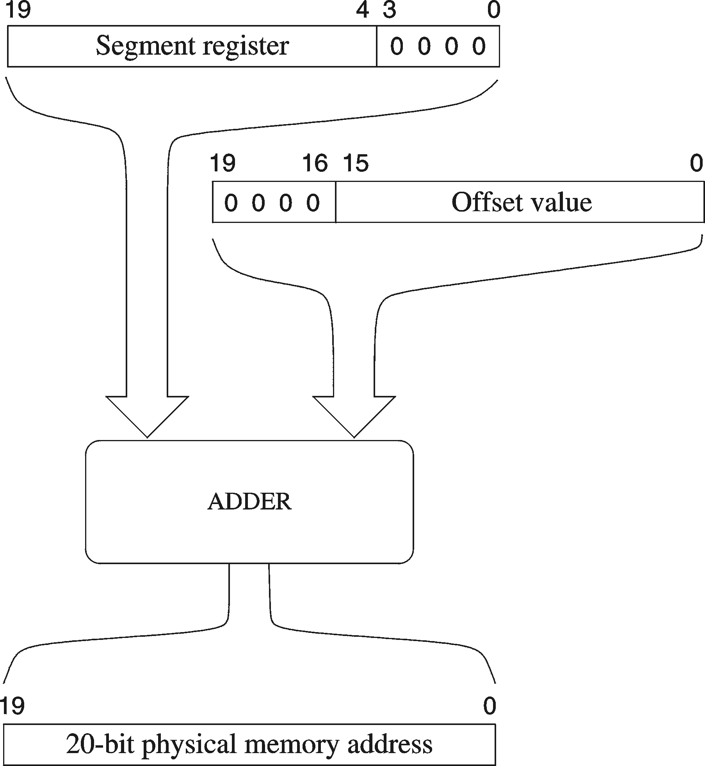
Logical to Linear Address Translation
Linear address = Segment × 10 (hex) + Offset
Example:
segment = A1F0 (hex)
offset = 04C0 (hex)
logical address = A1F0:04C0 (hex)
what is the linear address?
Solution:
A1F00 (add 0 to segment in hex)
+ 04C0 (offset in hex)
A23C0 (20-bit linear address in hex)

Slide 42
Your turn . . .
What linear address corresponds to logical address 028F:0030?
Solution: 028F0 + 0030 = 02920 (hex)
Always use hexadecimal notation for addresses
What logical address corresponds to the linear address 28F30h?
Many different segment:offset (logical) addresses can produce the same linear address 28F30h. Examples:
28F3:0000, 28F2:0010, 28F0:0030, 28B0:0430, . . .

Slide 43
Flat Memory Model
Modern operating systems turn segmentation off
Each program uses one 32-bit linear address space
  Up to 2³² = 4 GB of memory can be addressed
  Segment registers are defined by the operating system
  All segments are mapped to the same linear address space
In assembly language, we use .MODEL flat directive
  To indicate the Flat memory model
A linear address is also called a virtual address
  Operating system maps virtual address onto physical addresses
  Using a technique called paging

Slide 44
Programmer View of Flat Memory
Same base address for all segments
  All segments are mapped to the same linear address space
EIP Register
  Points at next instruction
ESI and EDI Registers
  Contain data addresses
  Used also to index arrays
ESP and EBP Registers
  ESP points at top of stack
  EBP is used to address parameters and variables on the stack
Linear address space of a program (up to 4 GB)
32-bit address
ESI
DATA
EDI
32-bit address
CODE
EIP
32-bit address
STACK
EBP
ESP
Unused
CS
DS
SS
ES
base address = 0 for all segments

Slide 45
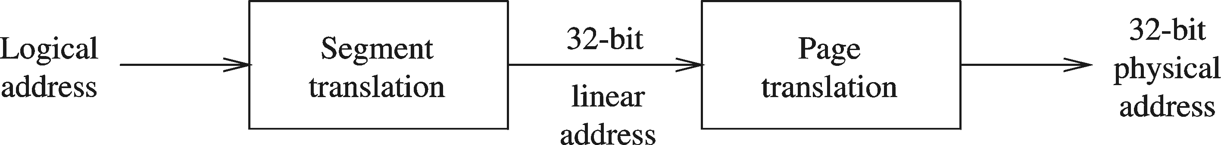
Protected Mode Architecture
Logical address consists of
  16-bit segment selector (CS, SS, DS, ES, FS, GS)
  32-bit offset (EIP, ESP, EBP, ESI ,EDI, EAX, EBX, ECX, EDX)
Segment unit translates logical address to linear address
  Using a segment descriptor table
  Linear address is 32 bits (called also a virtual address)
Paging unit translates linear address to physical address
  Using a page directory and a page table

Slide 46
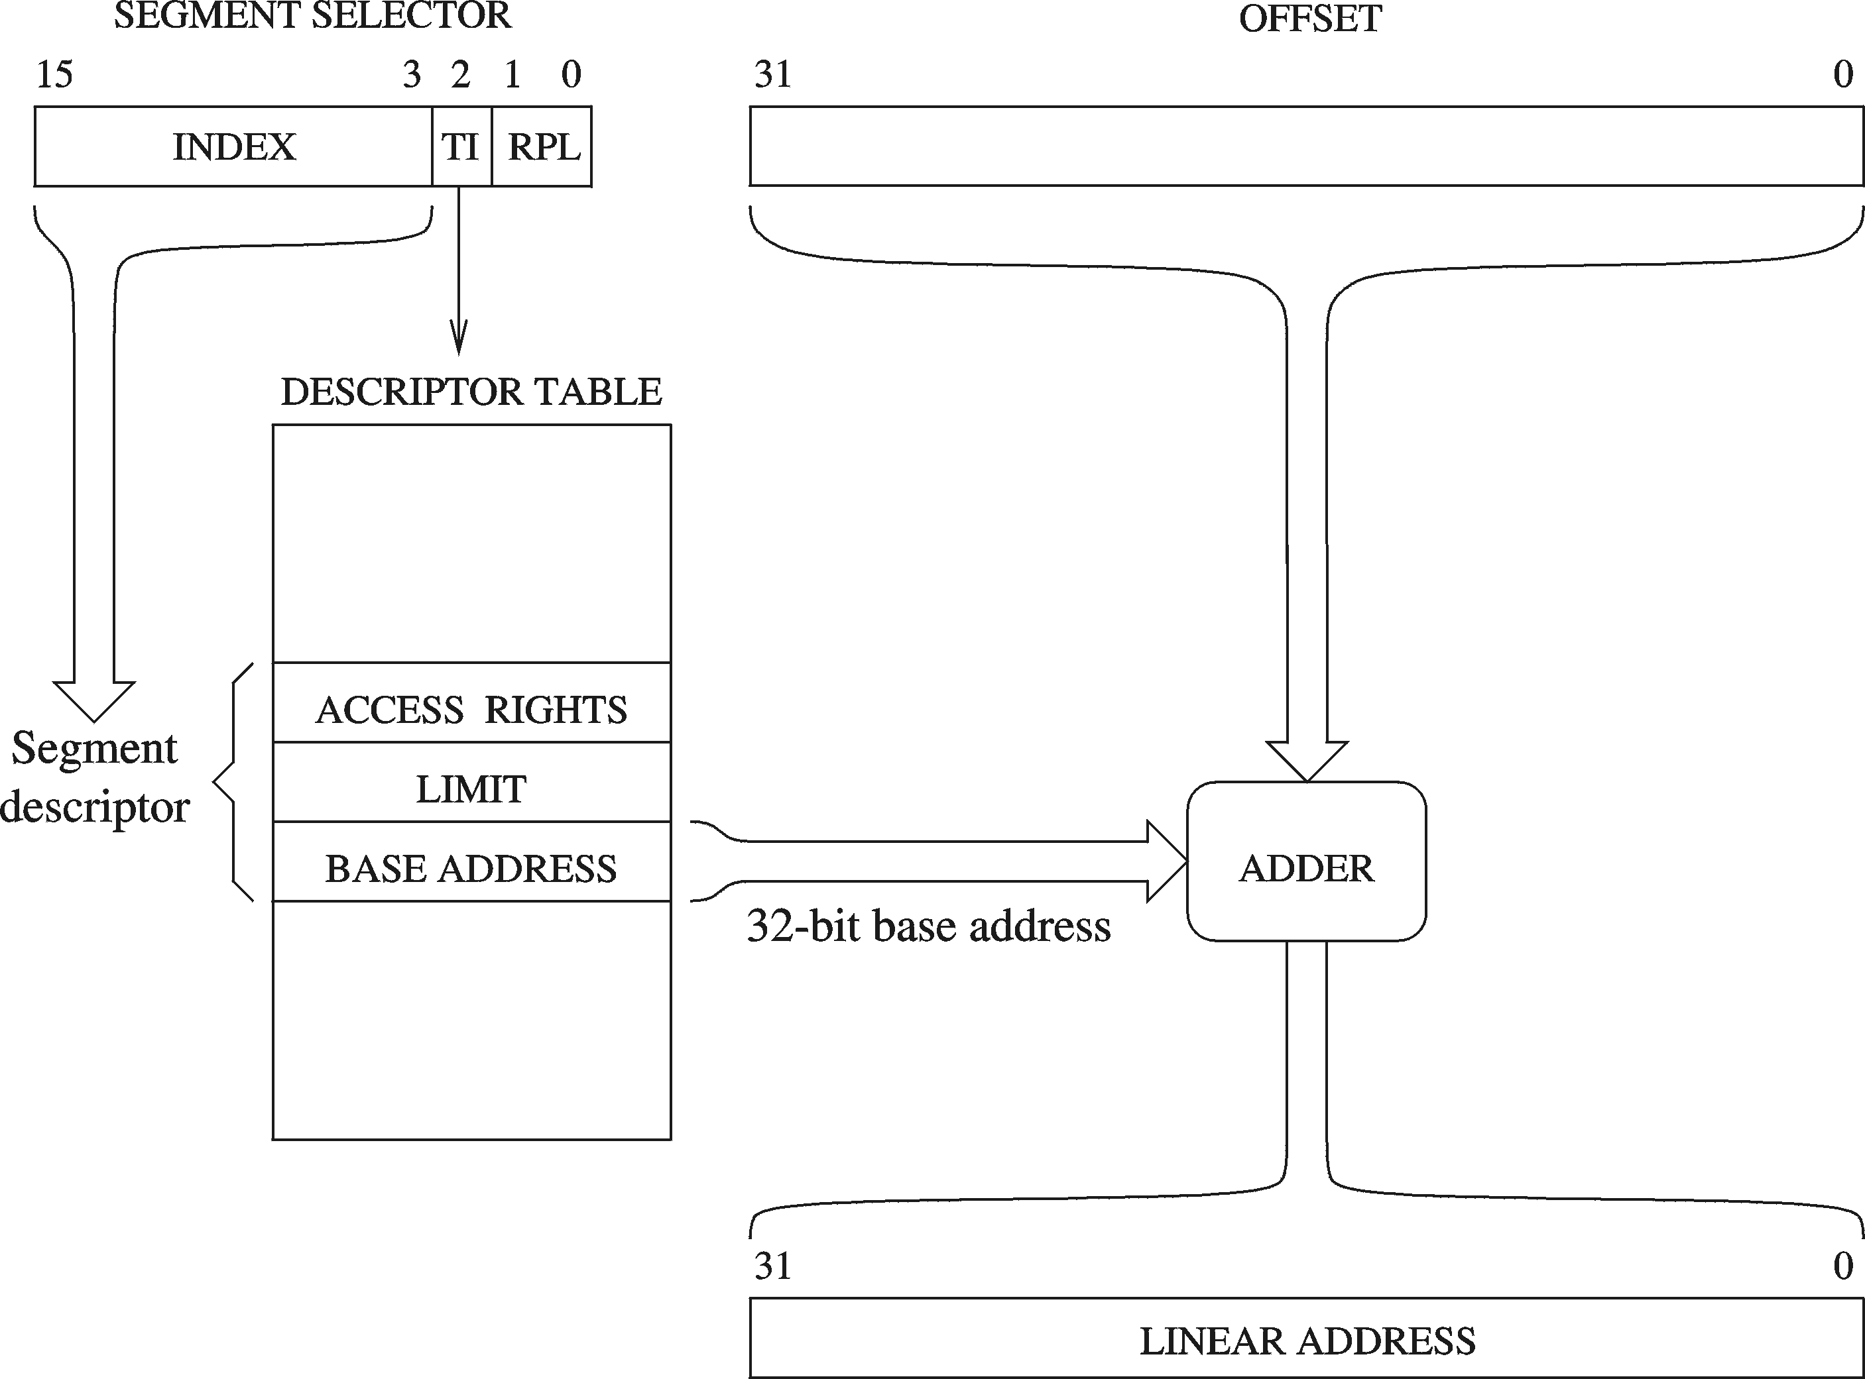
Logical to Linear Address Translation
Upper 13 bits of segment selector are used to index the descriptor table
GDTR, LDTR
TI = Table Indicator
Select the descriptor table
0 = Global Descriptor Table
1 = Local Descriptor Table

Slide 47
Segment Descriptor Tables
Global descriptor table (GDT)
  Only one GDT table is provided by the operating system
  GDT table contains segment descriptors for all programs
  Also used by the operating system itself
  Table is initialized during boot up
  GDT table address is stored in the GDTR register
  Modern operating systems (Windows-XP) use one GDT table
Local descriptor table (LDT)
  Another choice is to have a unique LDT table for each program
  LDT table contains segment descriptors for only one program
  LDT table address is stored in the LDTR register

Slide 48
Segment Descriptor Details
Base Address
  32-bit number that defines the starting location of the segment
  32-bit Base Address + 32-bit Offset = 32-bit Linear Address
Segment Limit
  20-bit number that specifies the size of the segment
  The size is specified either in bytes or multiple of 4 KB pages
  Using 4 KB pages, segment size can range from 4 KB to 4 GB
Access Rights
  Whether the segment contains code or data
  Whether the data can be read-only or read & written
  Privilege level of the segment to protect its access

Slide 49
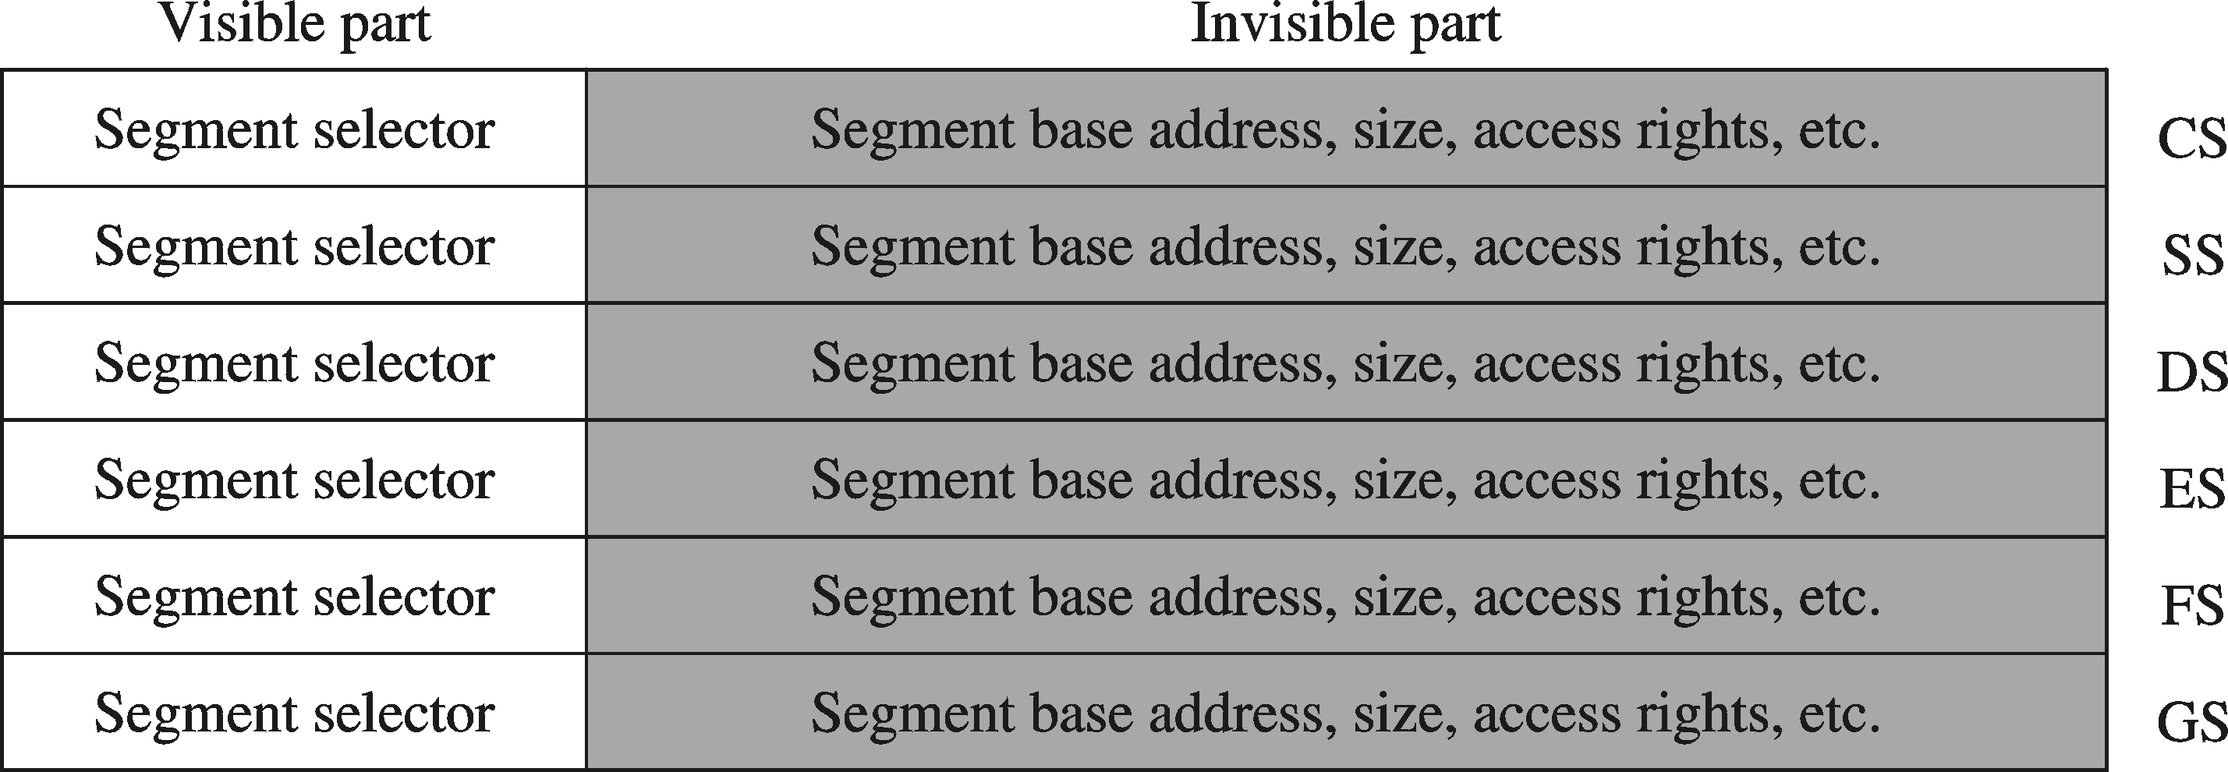
Segment Visible and Invisible Parts
Visible part = 16-bit Segment Register
  CS, SS, DS, ES, FS, and GS are visible to the programmer
Invisible Part = Segment Descriptor (64 bits)
  Automatically loaded from the descriptor table

Slide 50
Paging
Paging divides the linear address space into …
  Fixed-sized blocks called pages, Intel IA-32 uses 4 KB pages
Operating system allocates main memory for pages
  Pages can be spread all over main memory
  Pages in main memory can belong to different programs
  If main memory is full then pages are stored on the hard disk
OS has a Virtual Memory Manager (VMM)
  Uses page tables to map the pages of each running program
  Manages the loading and unloading of pages
As a program is running, CPU does address translation
Page fault: issued by CPU when page is not in memory

Slide 51
Paging – cont’d
Main Memory
The operating system uses page tables to map the pages in the linear virtual address space onto main memory
Page m
. . .
Page n
. . .
. . .
linear virtual address space of Program 1
linear virtual address space of Program 2
Page 2
Page 2
Page 1
Page 1
Page 0
Page 0
Hard Disk
The operating system swaps pages between memory and the hard disk
Each running program has its own page table
Pages that cannot fit in main memory are stored on the hard disk
As a program is running, the processor translates the linear virtual addresses onto real memory (called also physical) addresses

